Slide 1

Starting A Square Dance Club
or
How to stop shooting ourselves in the foot
The first lessons which led up to North Shore Squares began in September 2016. Summer of 2017 a club was formed. At this moment the club has more than 90 members. So the club is growing at a time when some clubs are shrinking. I thought I’d share the beliefs that guided me in case they might help other clubs wanting to grow their membership. Square dancing is one of the best activities available to people. There's absolutely no need for it to be in decline.

Slide 2
8%

Slide 3
8%
Our annual decline

Slide 4
USA National Conventions
1976 Anaheim, California 39,796

Slide 5
USA National Conventions
1976 Anaheim, California 39,796
2018 Kansas City, Missouri 3,169

Slide 6
Very Little Of This Is Original Thinking
I’ve heard countless people saying the same sort of thing as I’ll be saying.
The only reason I’m presenting this is that I took what I’d been hearing and gave it a shot.
A lot of people made an enormous contribution to the success of the club.
Others have done something similar with similar results.

Slide 7
Almost Anyone Could Have Done This
Nine years ago I was not a caller. These days I’m adequate.
I’d like to think I’m a good teacher and I mostly sing in key.
I was willing to put in the hours.
I had a lot of help.
And I’m a NICE GUY
Notes:
On the other hand, I think the most entertaining way to tell this tale is if I make the story about me. So

Slide 8
My Story
Took a square dance class when I was 11

Slide 9
My Story
Took a square dance class when I was 11
Then the family moved east and the square dancing ended

Slide 10
My Story
Took a square dance class when I was 11
Then the family moved east and the square dancing ended
In my early twenties I got involved in folk dancing

Slide 11
My Story
Took a square dance class when I was 11
Then the family moved east and the square dancing ended
In my early twenties I got involved in folk dancing
Within a couple of years I was teaching a Friday night class in Evanston
Notes:
Got up to 120 people a night

Slide 12
My Story
Took a square dance class when I was 11
Then the family moved east and the square dancing ended
In my early twenties I got involved in folk dancing
Within a couple of years I was teaching a Friday night class in Evanston
One Friday night a girl showed up

Slide 13
My Story
Took a square dance class when I was 11
Then the family moved east and the square dancing ended
In my early twenties I got involved in folk dancing
Within a couple of years I was teaching a Friday night class in Evanston
One Friday night a girl showed up
You can imagine at least part of the rest of the story

Slide 14
KDI
Kentucky Dance Institute – KDI

Slide 15
KDI
Kentucky Dance Institute – KDI
Unfortunately we were expected to square dance for an hour every day. I didn’t want to.

Slide 16
KDI
Kentucky Dance Institute – KDI
Unfortunately we were expected to square dance for an hour every day. I didn’t want to.
Why? I had loved square dancing. Why did I think it was stupid and for hicks?

Slide 17
KDI
Kentucky Dance Institute – KDI
Unfortunately we were expected to square dance for an hour every day. I didn’t want to.
Why? I had loved square dancing. Why did I think it was stupid and for hicks?
I had forgotten that I’d ever square danced and instead picked up the general consensus about square dancing.
Notes:
And it goes back to this image.

Slide 18

Notes:
This image is ubiquitous. In my life I had never seen a woman wearing petticoats except on the TV. Every time a park district does a flyer for us they find this on the web and use it. I will mention that it has been the logo for MCASD for many years and when people wanted a new logo the old guard was adamant it must not be changed.
Notice the guys bandana. Notice the woman’s hair style. Notice the petticoat.

Slide 19
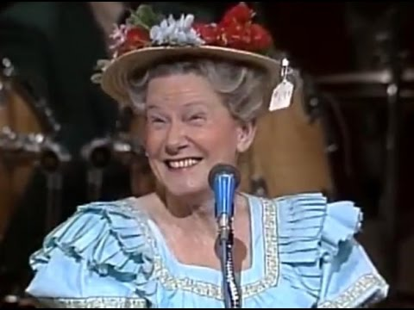
Minnie Pearl
Notes:
I hear she was a delightful woman.

Slide 20
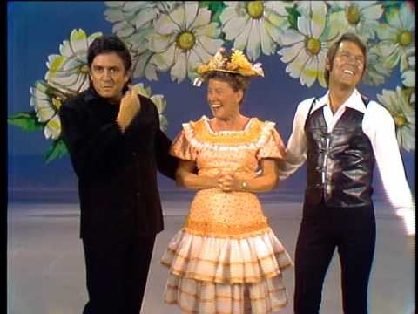
Johnny, Minnie & Glen
Notes:
And there she is in all her sartorial splendor. I do realize she was going for a comedic look. Of course the show was. Johnny Cash & Glen Campbell

Slide 21
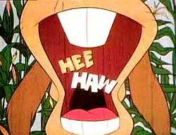
And the show was

Slide 22
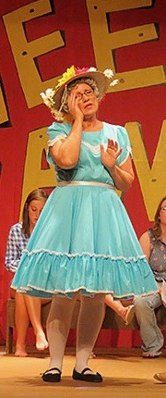
Teresa Russell
Notes:
Except for her belt not being wide enough, that’s a perfect square dance outfit. My bias is that’s not a flattering look. And once you connect square dancing with Hee Haw you’ve got a lot of baggage you’ve acquired. The jokes on Hee Haw were pretty bad.

Slide 23
KDI continued
We square danced all week and had a blast

Slide 24
KDI continued
We square danced all week and had a blast
When we got home, should we take lessons?

Slide 25
KDI continued
We square danced all week and had a blast
When we got home, should we take lessons?
Crinolines?

Slide 26
KDI continued
We square danced all week and had a blast
When we got home, should we take lessons?
Crinolines?
Took lessons with Fascinating Singles

Slide 27
KDI continued
We square danced all week and had a blast
When we got home, should we take lessons?
Crinolines?
After a few years we were doing C1 in a private home

Slide 28
KDI continued
We square danced all week and had a blast
When we got home, should we take lessons?
Crinolines?
After a few years we were doing C1 in a private home
By now we were married

Slide 29
KDI continued
We square danced all week and had a blast
When we got home, should we take lessons?
Crinolines?
After a few years we were doing C1 in a private home
By now we were married
A child showed up. We’d carry the kid as we danced. More kids. The kids got heavier. A small scandal. The group disbanded.

Slide 30
The Lost Years
The wife and I stopped dancing.
Notes:
Would you ever want to try square dancing? Crinolines. For Joy it was more a matter of what would be comfortable rather than caring about fashion.

Slide 31
The Lost Years
The wife and I stopped dancing.
A decade later the wife fell in love with someone else.
Notes:
Vendors 2 new cowboy shirts. A session on how to get more people into square dancing. Talk about Detroit before moving on.

Slide 32
The Lost Years
The wife and I stopped dancing.
A decade later the wife fell in love with someone else.
A year later I met someone new at English Country Dancing.
Notes:
Vendors 2 new cowboy shirts. A session on how to get more people into square dancing. Talk about Detroit before moving on.

Slide 33
The Lost Years
The wife and I stopped dancing.
A decade later the wife fell in love with someone else.
A year later I met someone new at English Country Dancing.
We spent a year doing barn dancing (contra).
Notes:
Vendors 2 new cowboy shirts. A session on how to get more people into square dancing. Talk about Detroit before moving on.

Slide 34
The Lost Years
The wife and I stopped dancing.
A decade later the wife fell in love with someone else.
A year later I met someone new at English Country Dancing.
We spent a year doing barn dancing (contra).
And then she asked the question.
Notes:
Vendors 2 new cowboy shirts. A session on how to get more people into square dancing. Talk about Detroit before moving on.

Slide 35
The Lost Years
The wife and I stopped dancing.
A decade later the wife fell in love with someone else.
A year later I met someone new at English Country Dancing.
We spent a year doing barn dancing (contra).
And then she asked the question.
After 9 months of lessons – 2011 Detroit National
Notes:
Vendors 2 new cowboy shirts. A session on how to get more people into square dancing. Talk about Detroit before moving on.

Slide 36
The Lost Years
The wife and I stopped dancing.
A decade later the wife fell in love with someone else.
A year later I met someone new at English Country Dancing.
We spent a year doing barn dancing (contra).
And then she asked the question.
After 9 months of lessons – Detroit National
Thursday morning
Notes:
Vendors 2 new cowboy shirts. A session on how to get more people into square dancing. Talk about Detroit before moving on.

Slide 37
Problems With Square Dancing
Terrible Image
You only get to start lessons in September
Lessons take too long. These days 9 months is FOREVER!
Hard to learn
  20% can’t
  20% have a very hard time of it
  20% are your all-stars
  40% will succeed if given enough time

Slide 38
But We Don’t Give Them Enough Time
No caller I know of believes the average person can learn Plus in nine months
And yet that’s how it’s offered in Chicago
Because the Plus clubs need Plus dancers
Asking people to take classes for nine months before they get to go dancing not is realistic in today’s world

Slide 39
An Average Class
12 Start
6 drop out, it doesn’t suit them, and it’s 9 months!
4 kinda make it through to the end of classes
2 (if you’re lucky) totally get it and thrive
Those 4 that kinda made it don’t dance over the summer, come to a dance in September and repeatedly crash the square. On the way home in the car … You end up with 2 dancers
Notes:
But they really don’t master the material.

Slide 40
Glenview Squares’ Problems
& The Ad Hoc Committee
We had to create Plus Dancers
We couldn’t offer a lower level without offering dances at that level
The square dancers were already sitting out half our regular dances so the Round Dancers could dance
We lacked the strength and resources to offer a second series of dances at lower level
We had no solution
Notes:
Explain the Ad Hoc Committee

Slide 41
The Ad Hoc Committee
We brought in a new caller
We developed new advertising
We scoured the available materials from Callerlab for ideas
We offered Intro Parties with lots of deserts
We did better. Class size doubled
But ultimately the results weren’t great

Slide 42
The Unthinkable
Club50 – Callerlab’s SSD, Social Square Dance
We only had a handful of Round Dancers
Could we drop the Round Dancing?
We warned our 50 some members that next season we wouldn’t be Round Dancing
The Round Dancers told us we were destroying the club and quit
We began teaching Club50 classes twice a year
High/Low approach at dances
By the end of that year Glenview had 90 members

Slide 43
Stealing & Retrieving
Joy and I live in Evanston along the lake front
Most dances at least an hours drive away
Dance for one hour
Watch people round dance for an hour
Hour’s drive home
Four hours = one hour of dancing
And this is how we’re going to keep square dancing alive?

Slide 44
Starting North Shore Squares
All the Park Districts I approached were enthusiastic about offering the lessons.
Offered a class on three different nights of the week through three different park districts.
Posters were key. Very few signups from parks.
I offered Free Intro Parties. Hugely important.
Having no club might have been a blessing.
Notes:
Problem with clubs in their seventies providing angels for a new class.

Slide 45
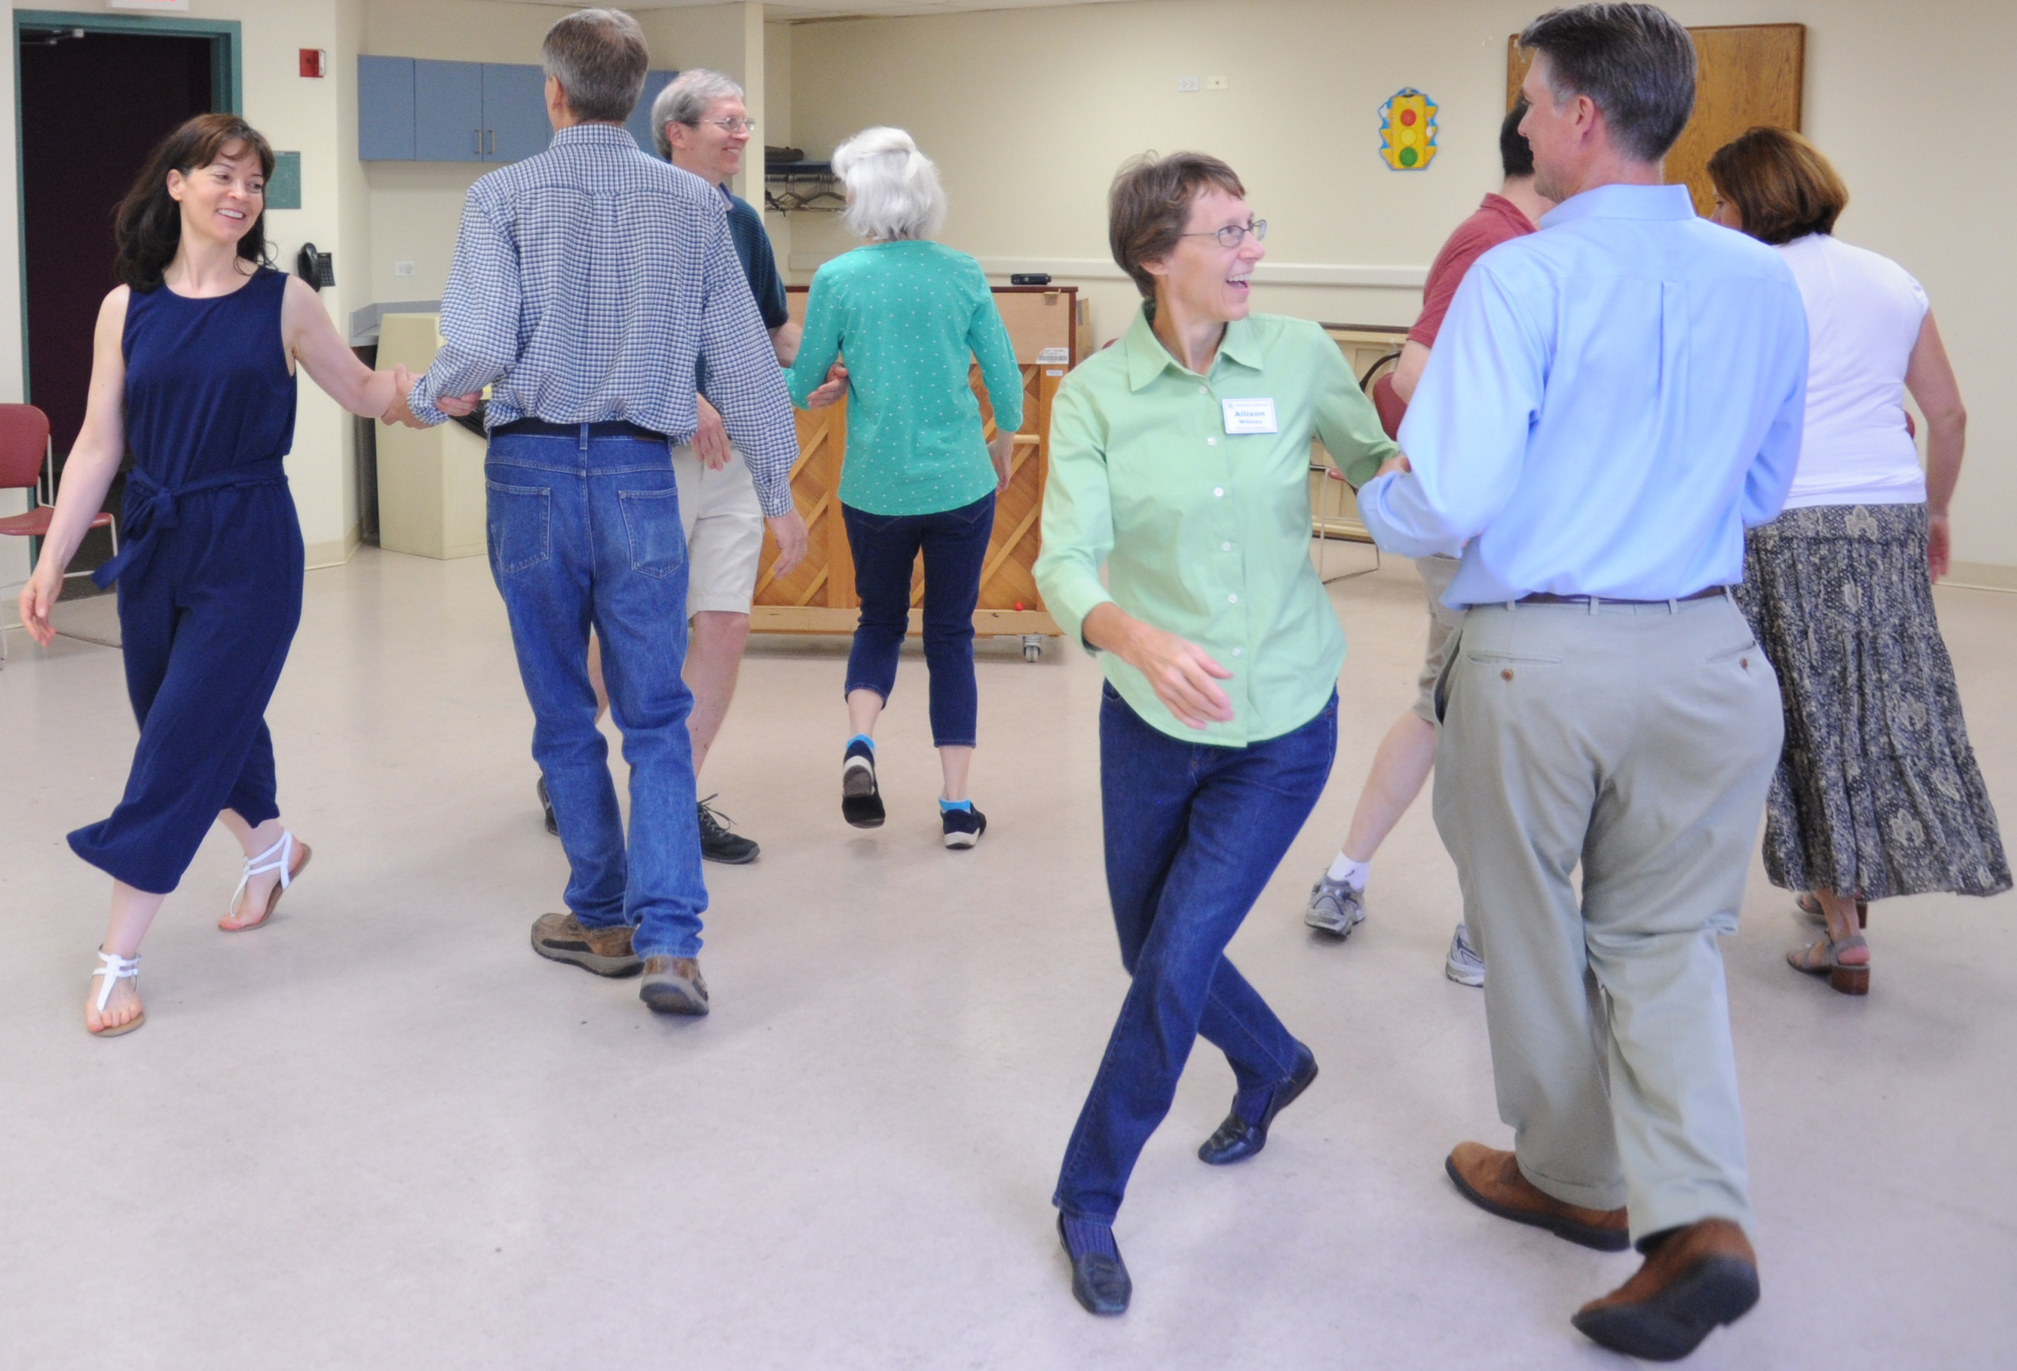
Today’s Square Dancing
It’s not what you think
Today’s square dancing does not involve frilly petticoats, cowboy outfits and old fashioned music. We wear what we like and dance to everything from the Beatles to modern country to pop favorites. It’s not even dancing. It’s just walking to music. It’s a little like football, except without the concussions. You’ve got formations. You’ve got a team around you. You’ve got plays sent in by the caller. The challenge is: can you run your route successfully?
Now granted, the team is coed, but that’s a positive feature. The team is made up of couples and singles—no partner required! You’re working together with seven other people and when you nail the outcome, it’s really quite exhilarating! All that is necessary is the ability to sustain a fast walking pace and a positive attitude. A quick mind and the love of a good puzzle can also help! If you enjoyed geometry in high school, you’ll get a kick out of this stuff.

Slide 46
Postering
Store Windows
Store Bulletin Boards
Coffee Shops - Starbucks
Train Stations – especially ones with a waiting room: Trifolds
Civic Centers / Community Centers
Libraries
KEEP TRACK OF YOUR RESPONSES

Slide 47
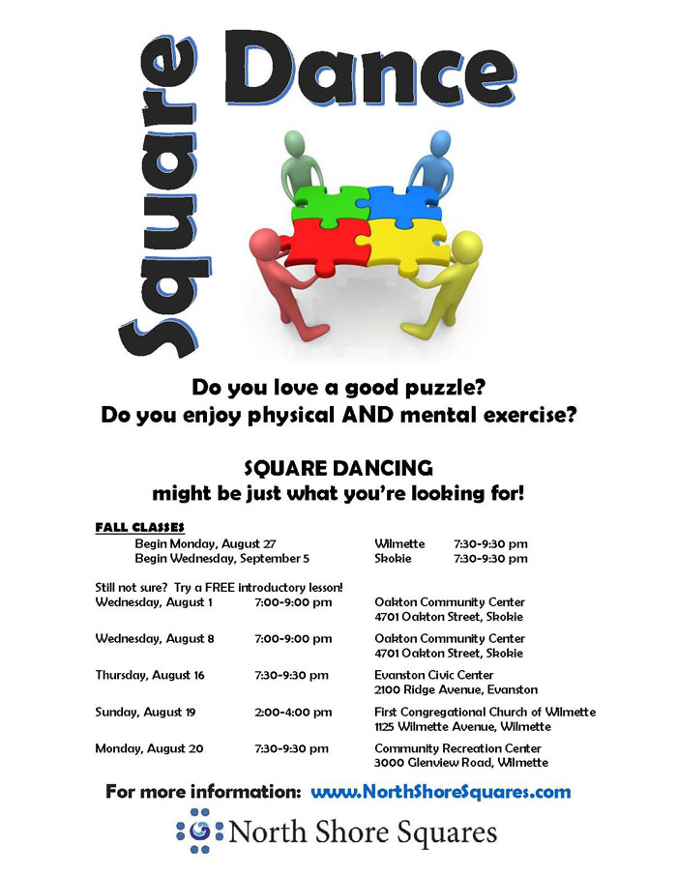
A Class Poster

Slide 48
Free Intros
Use the most modern music you can find.
Do not show up dressed like a cowboy.
Understand that people want to dance with people their own age. If your club is old, that gives the impression, this is an old people’s activity. You then have a mountain to climb.
I’m old, but I didn’t have a room of old angels.
Do not reinforce negative stereotypes.
I do not teach them DoSaDo. Why not?
Notes:
Play my music.

Slide 49
My Intro Party Preferences
Do not make squares until you have to.
Start in big circle with Circle Left & Circle Right.
Initially, I call from within the circle using head mic.
The key is making noise on Forward & Back.
Ask them if they succeeded. Let them celebrate.
Partners, Corners, Arm Turns, Allemande Left.
Sicilian Circles: Pass Thru, Circle Left, Stars.
Only then do we make squares.
Grand Squares. End with singing call.

Slide 50
The First Year
Next to no angels. Calling from the square. Rectangles. In an emergency, could call Joy or a friend from Glenview.
We encouraged the women who could to learn both right and left-hand positions. They alternated week to week.
Taught 2 Club50 classes in both fall and spring.
A year later I asked if the students I’d taught would like to start a square dance club.
We had a meeting at my house to form the club.

Slide 51
The First Year
Half the possible membership showed up. The amount of enthusiasm and energy was remarkable. I find myself wondering if some of that was because there was no club. We weren’t asking someone to take over old responsibilities. There was no one already in place. The team couldn’t just leave it for the old guard to continue. It was volunteer or it wouldn’t happen.

Slide 52
The First Year
Dues would be $90 and pay for 7 dances and badges.
The club started at 28 members.
Membership is increasing by about 20 members a year. In the 90s now.
Dues are down to $75 for 9 dances.

Slide 53
Lesson Support
Each week they get an email with links: Taminations
Each students gets a collection of flash cards
They have the ability to attend lessons outside of class by attending the concurrent class
Saturday drill sessions
Multiple classes allows the classes to come together for a dance geared to their level. MCASD does this as well. But the dances have to be very low level due to the different class levels.
The club has video lessons available on the NSS web
Each student receives a 42 page book we’ve created with all the calls they’ll be learning organized by lesson
Notes:
Jill Sullivan

Slide 54
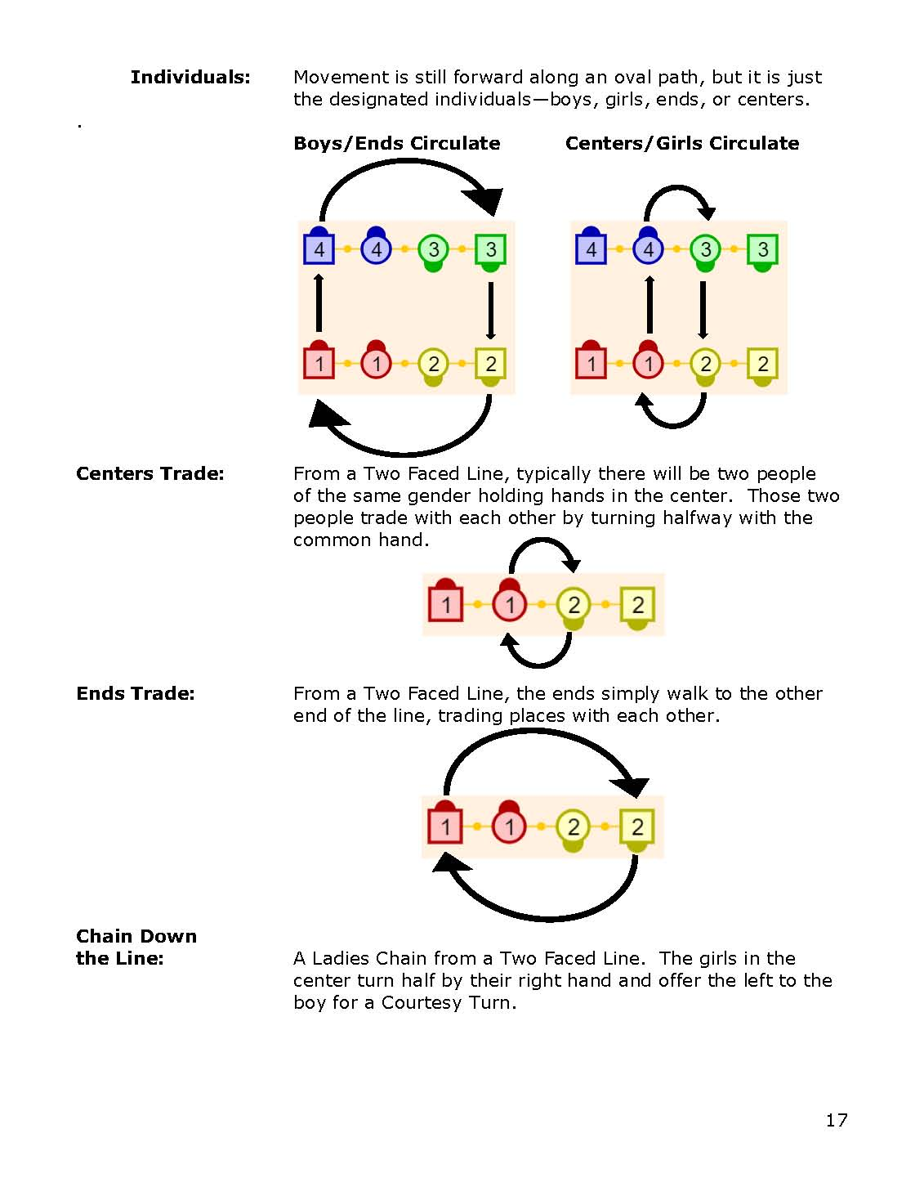
Notes:
And This is a page from the lesson booklet that the students get. Show the book. It’s on the web site. Jill Sullivan again.

Slide 55
Our First Year Of Dances
I started trying to put a dance schedule for the following season together before we had a club.
Found a room for $45 a night that would hold 6 squares (a little tight but we could do it).
Called the callers I liked. Offered the house minus $45 for the rental. Since I had no club I was kinda desperate. Needed them to take a chance on us.
My team thought my venue choice was crazy. “What if we have big crowds?” We found a new location with gothic windows and three times more space for the same price.

Slide 56
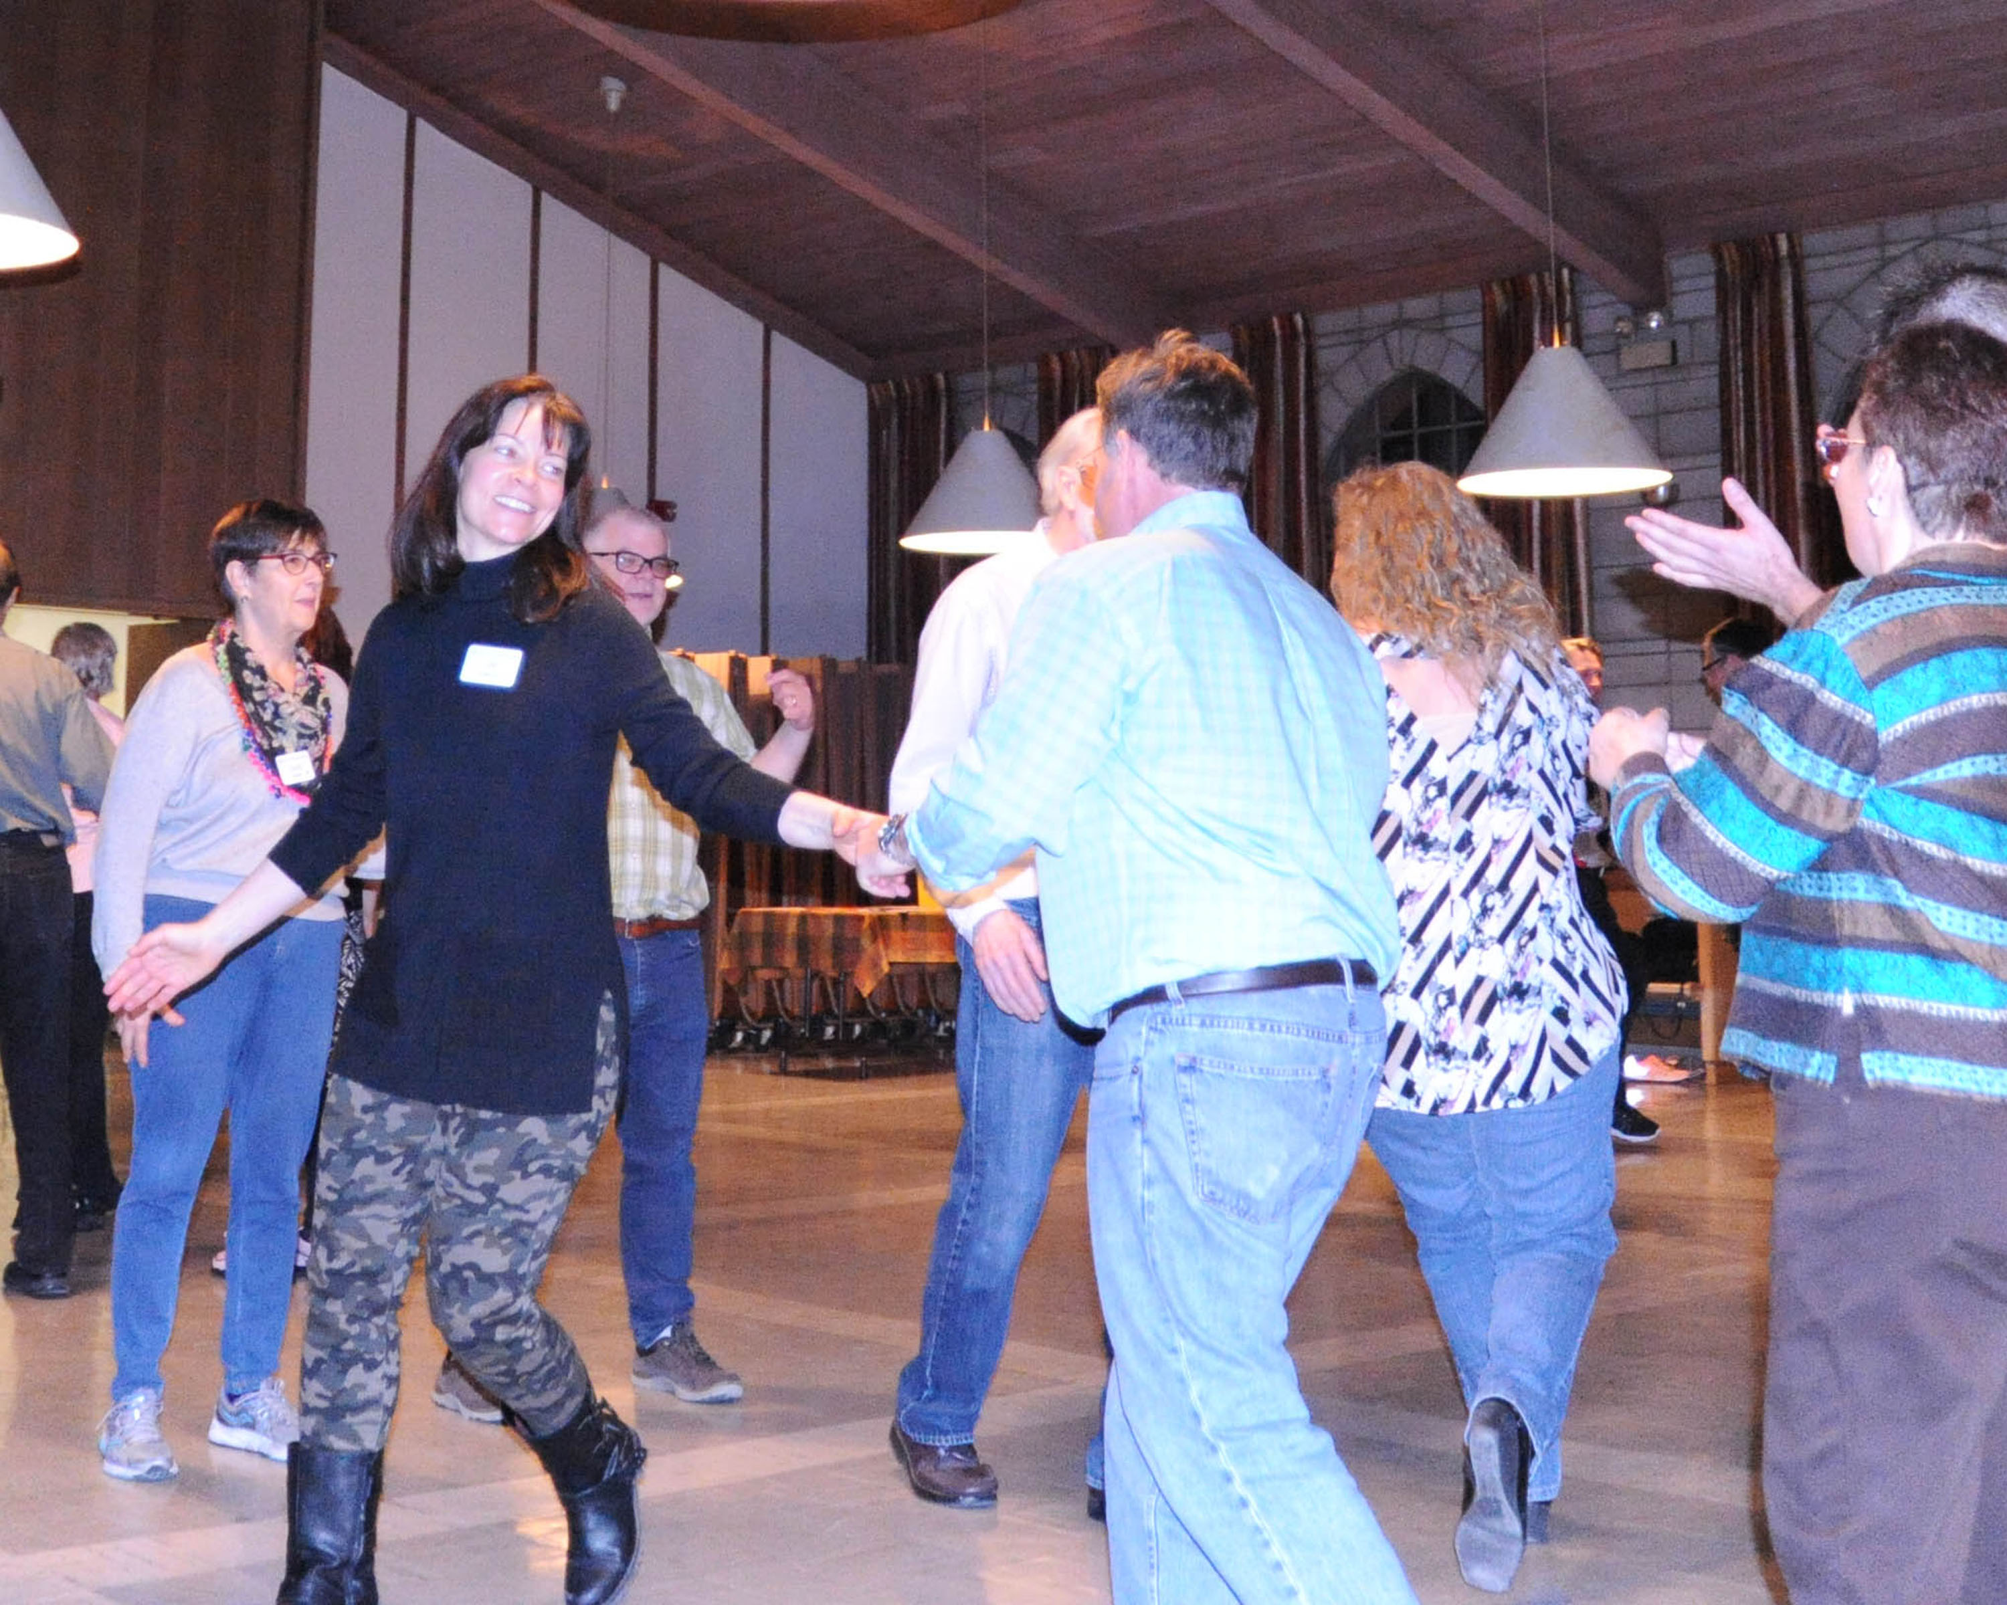
Attendance got up to 9 squares
Notes:
Notice the lighting. It felt more like a nightclub than a gym. There’s Jill, And here’s a poster she created for this year’s offerings.

Slide 57
We Need More Callers
Very strong first class. Dave Mischler liked to teach. When you’ve got someone like that, stay out of their way. Let them teach.
Dave started offering free drill session’s on Saturdays as a way to help the students and give himself the chance to run a class.
Now he’s a full fledged caller.
Last year there were four brand new callers teaching for the club.

Slide 58
First 12 Months
Formed club. Became incorporated.
Offered a Plus Class and Four Club50 classes.
People could attend the other class for extra practice or if the knew they’d have to miss.
Dave’s drill session’s on Saturdays.
Blast offered 4 consecutive Saturdays
Offered a summer class.
Club does not take the summer off. Summer dance series each Tuesday night.

Slide 59
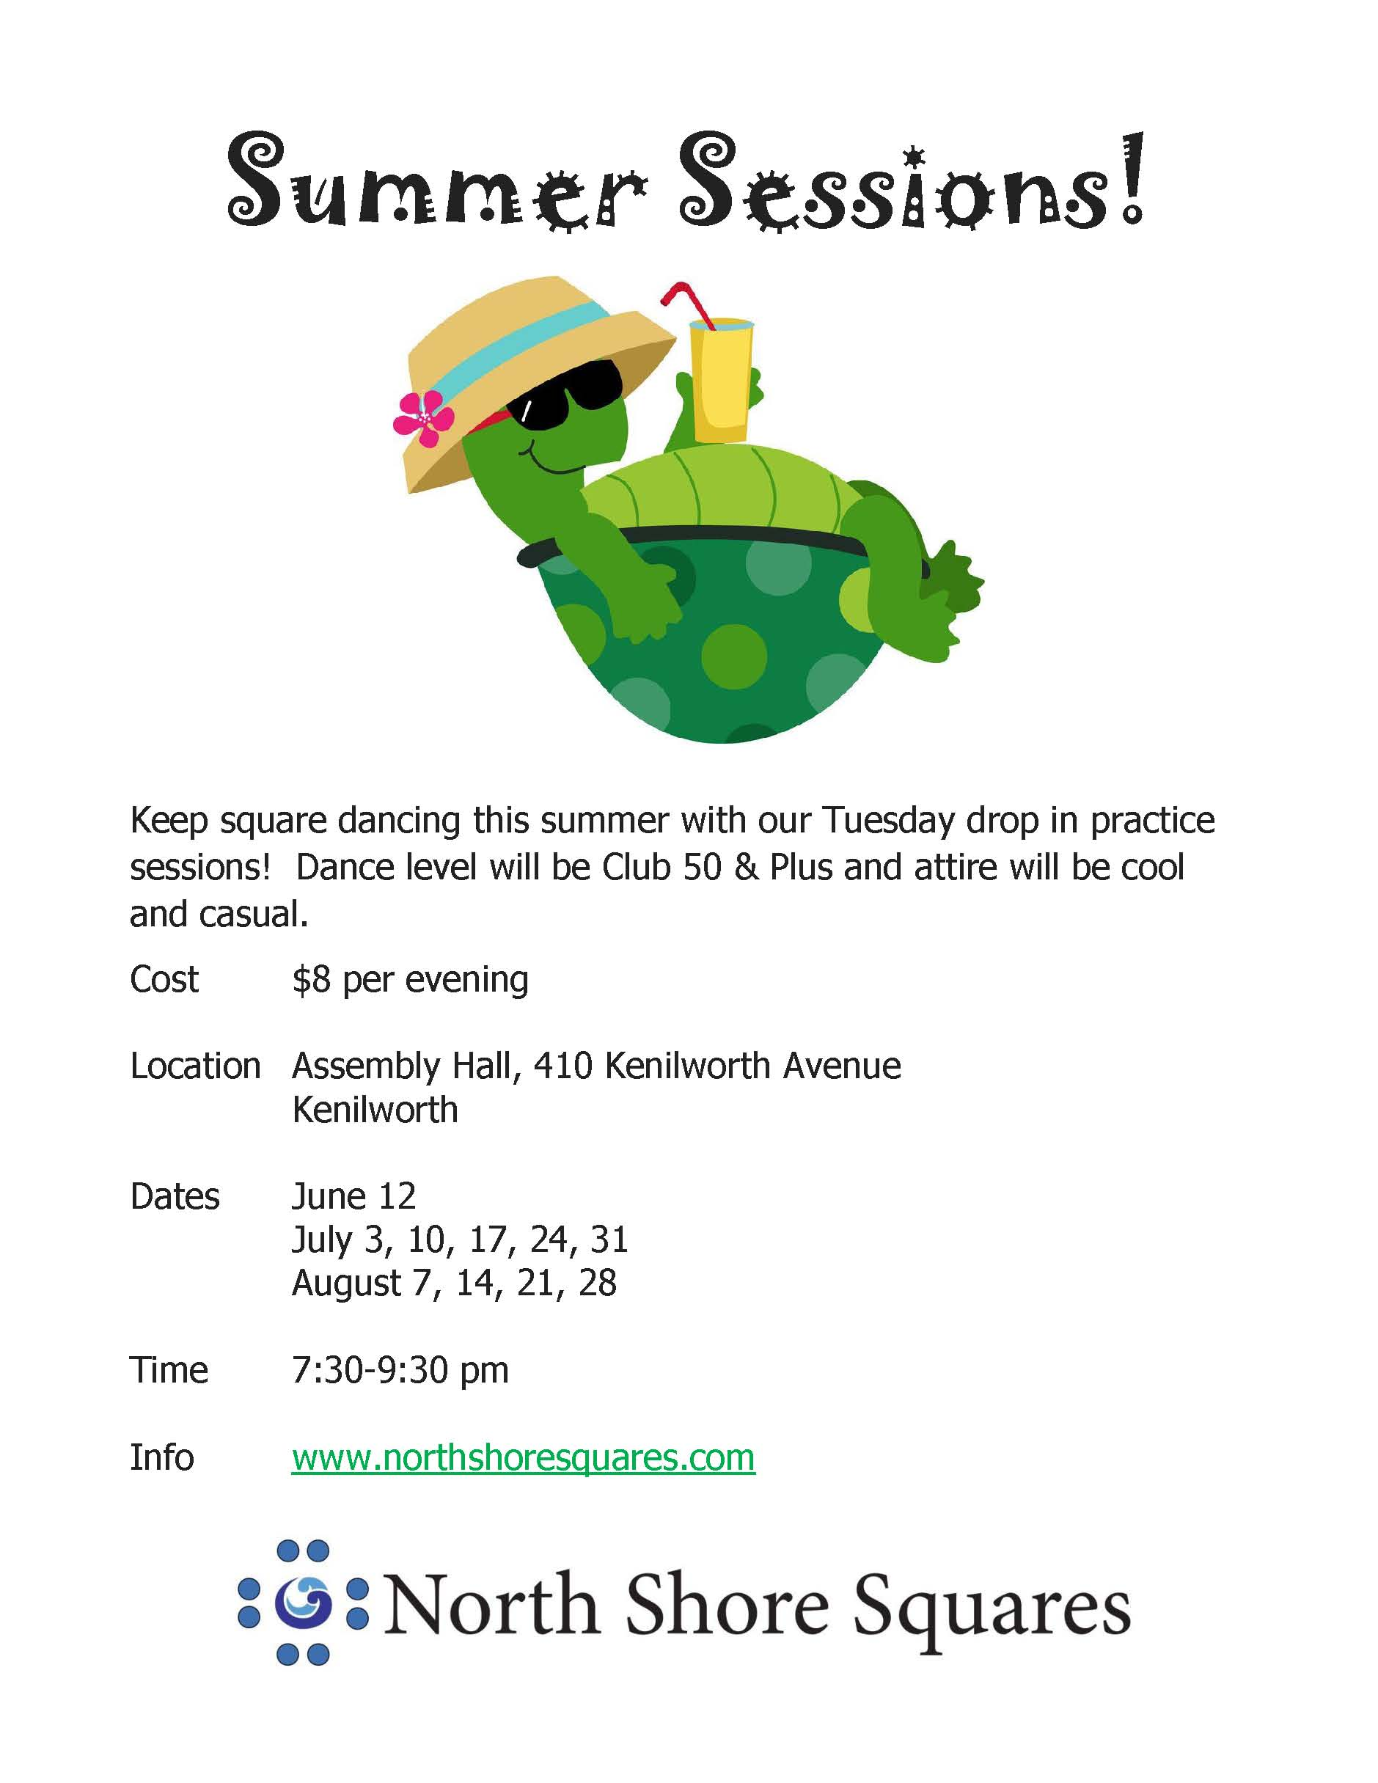
We get 4 to 6 Squares each week at the Summer Dances

Slide 60
The Flaw In What We’ve Done
Ideally, Club50 should be a destination.
But at Glenview and North Shore it feels more like a way-station.
When you have that higher level it feels like all the cool kids are heading there and a subtle pressure develops to move up as well. It’s the Peter Principle.
Not everyone should dance Plus.
Notes:
And I’m going to take that one step further ….

Slide 61
Not Everyone Should Square Dance
Rocky Mountain has a very high retention rate
But they try and screen out the confused ones
I try and tell people that it’s not for everyone
You can be a genius at poetry and bad at math
When someone isn’t getting it we talk to them
We don’t allow someone to make it impossible for the rest of the students to learn
We don’t send bad dancers out thinking they can dance – worse part of the job

Slide 62
Ideas To Explore
The club would like to have a class that meets twice a week and finishes twice as fast. How would that effect retention of the information between classes?
If the class is finished in 9 weeks, you could offer classes beginning in September, November, January & March. That gives people choices on what month they’re free to start lessons. It means not having to wait till next September to take lessons.
Notes:
Credit Rocky Mountain.

Slide 63
Resources
That idea of twice weekly classes came from Jim Langdon’s Rocky Mountain Recruiting Plan. Another recommendation is Square Dance Marketing Manual by Mike Hogan and Callerlab.
There’s a lot of material on the Callerlab Knowledge database. Search for North Shore Squares.
North Shore will have four new callers teaching classes this fall.
Becoming A Square Dance Caller.

Slide 64
Just Do It
In summation I would say you have to avoid reinforcing the negative image of square dancing. But other than that it's just a matter of doing it. It's a lot of hard work, but if you're willing to do the work, it's completely possible. I got lucky in terms of the people who stepped forward when forming the club. But other groups are having similar successes.
We have a wonderful product. We just have to sell it right.

Slide 66
Resources
Becoming A Square Dance Caller: http://brucetholmes.com/Becoming.html
On the Callerlab Knowledge Base
http://callerlabknowledge.org/north-shore-squares-zero.../
NORTH SHORE SQUARES – ZERO TO 50 IN 18 MONTHS
Definition Booklets
Flash Cards
Call Videos: https://www.northshoresquares.com/copy-of-alphabetical-club-50-videos
Bruce@BruceTHolmes.com

Slide 67

Thanks For Listening
Questions?
Notes:
Ask whoever’s there to join you.

