Slide 1
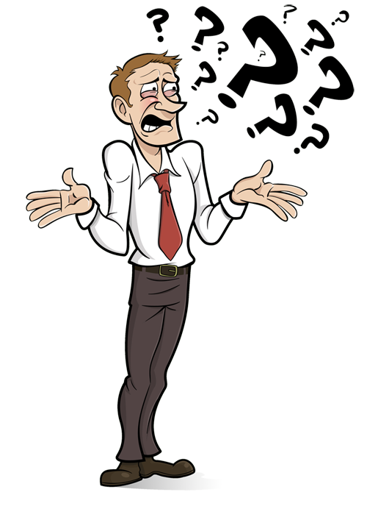
Communication – Those difficult people
Every Caller will face a difficult situation
Caller
Dancer
It is important to diffuse - not deflect
Effective Communication is the key to understanding
Things can be said in more than one way and still be clearly understood
Mel Wilkerson
28 Royce Cres
Lavington NSW 2641 Australia
wilkerso@bigpond.net.au

Slide 2

Effective Communication Principles
Always be professional
Use open questions (How and What)
Paraphrase for Confirmation
Active Listening
Explore options
Examine Consequence as appropriate
Agree on Action Steps and Time Frames

Slide 3
Dealing with those difficult people
Not every Square Dance Situation is pleasant and that is stressful
Consider – Everyone is doing “Their Best” from “Their Perspective”
We Have all been there – (Or we will be)
Someone has a different opinion
Not impressed by what you said or did
Think they are better/more knowledgeable than you
Are Jealous or worse, afraid of your potential and it threatens them
Hundreds of reasons
Some People are just “A@#$-0l3s” !!

Slide 4

Difficult People – The Management Secret
FOUR QUESTIONS
What just happened?
What are the feelings arising in me?
What do I need that I am not receiving”
What am I asking for?
You must start with introspection
NOT REACTION

Slide 5
Step 1 of 7 - S.T.O.P. – Avoid Reactivity
Stop – what ever you are doing – especially a knee jerk reaction
Take – 3 deep breaths and centre yourself
Observe – how do you feel? – angry, burning ears, embarrassed etc.
Proceed – with kindness and compassion. – (this is often hard to do)
You only have control of your own reactions

Slide 6
Step 2 of 7 – See through the “Control Drama”
Four primary control Dramas
Being Nice and Manipulative
Being Nasty and Manipulative
Being aloof and withdrawn
Playing the victim “oh poor me” role
“Control Dramas” are learned “Default Behaviours”
Recognition shifts perspective
Allows you to direct the relationship dynamic

Slide 7
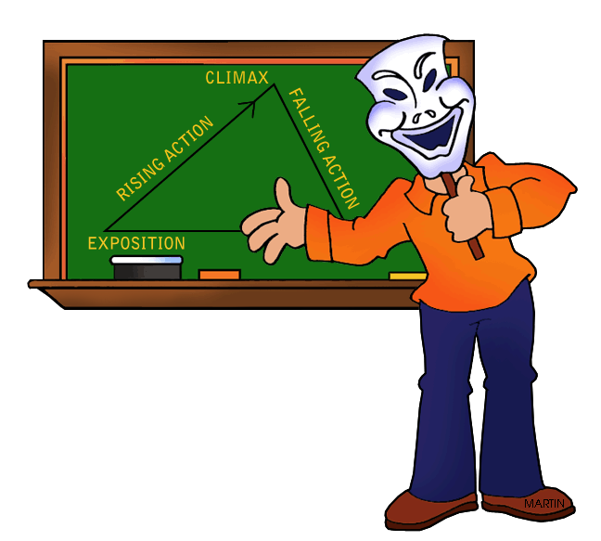
Step 3 of 7 – Don’t take it personally
Most of the time it feels like a deliberate attack
It is not about you – it is about them
How you react is based on their perception
you are only an actor in their show.
Note: they are only bit players in your drama too
Refusing the personal attack defuses ego and helps de-escalate conversation and conflict

Slide 8
Step 4 of 7 – Practice Defencelessness
Defenceless DOES NOT mean passive.
Maintain your opinion and perspective (unless you are wrong)
Give up the need to be the “smartest person in the room”
Hard for callers because of EGO.
Their opinion is valid, not right or wrong, just valid
Avoid the first reaction – “Defending your point”
Acknowledge the value of their point, right or wrong first.
Allow them to be heard “in Full”
This creates discussion space

Slide 9

Step 5 of 7 – Sometimes – JUST WALK AWAY
Difficult people have a “negative field” – Remove yourself
You have nothing to prove – Don’t be a Martyr
Acknowledge their opinion - and leave them with it
Business cards are a great tool for delay and thought
Validate the existence of their opinion
Do not engage in it

Slide 10

Step 6 of 7 – Evolutionary Opportunity
Each encounter is a learning experience
Hold up a mirror to yourself
They are in your class, but:
You are in their class too
What did you learn in this situation?
Write it down.

Slide 11

Step 7 of 7 – (The hardest one) – Resonate Compassion
Be compassionate and understanding
Difficult people are suffering and need relief
Respond reflectively and not reactively
We all do the best we can with what we know
“Know more - do better” applies both ways
Empathy – Not Sympathy

Slide 12
Square Dance Sociability – Relationship Building
Kindness – It takes two to make an argument
Compassion – makes them respond positively
Common Ground – Connection building
Stay Calm – patience and reflection before reaction
“Share” your side. – They may have a different perspective.
Respect – no respect = no communication
IGNORE THEM - You don’t need that in your life.
Control – Control yourself and the situation

Slide 13
Square Dance Sociability – Relationship Building
Control – Control yourself and the situation
Look at yourself – Are you the cause?
Don’t Fear Conflict – Don’t start it but do not fear it.
Eye Contact – be culturally aware
Positive Body Language – project confidence
Praise their strengths – hard to argue with praise
What are they saying - words/voice/body
Provide Value – Do you want to be happy or right?
Do not be a negative transmitter

Slide 14
INTROSPECTION
Am I the cause - the answer is normally “YES”.
HEADS FACE GRAND SQUARE – are you calling it right?
You have no control of the simple facts
This dancer thinks he / she is right.
This dancer does not understand the definition
This dancer has not / or may not have been taught right
This dancer may have been specifically told it is always “Sides Face”
This dancer doesn’t care about public perception of him/herself as long as the point can be pressed
This dancer likes to be the focus of attention
The only thing you can control here is your reaction

Slide 15
10 Effective Conflict Resolution Criteria
Validate – acknowledge their right to an opinion
Think like them – What is their perspective
Do not resist. What you resist, persists.
Head Tilt – It makes them feel heard
Plan your outcome – how do you want to feel at the end
Lessons Learned – what is the life lesson here
Strategic Influence – Who influences that person – use them
Create a Bond – find something to agree on (positive)
Downplay the Situation – Don’t feed negativity
Interrupt the pattern – recognise it and disrupt the patterns

