Slide 2
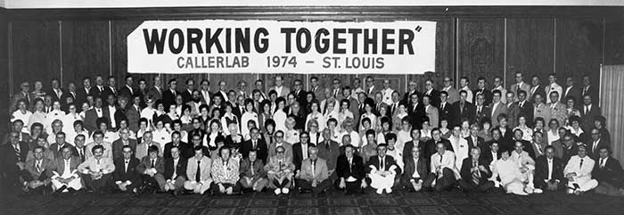
History

Slide 3
Mission Statement:
To foster the art of square dance calling and improve caller skills.

Slide 4
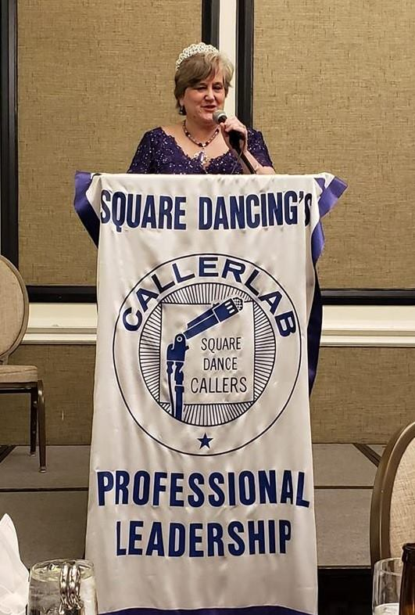
Leadership
Board of Governors
Executive Committee
Home Office

Slide 5
Annual Convention
The Convention is where callers and partners meet and visit annually. Many interesting and educational topics are programmed and presented by members. Attendees travel from as far away as Japan, Australia, Europe, Canada, and across the USA.

Slide 6
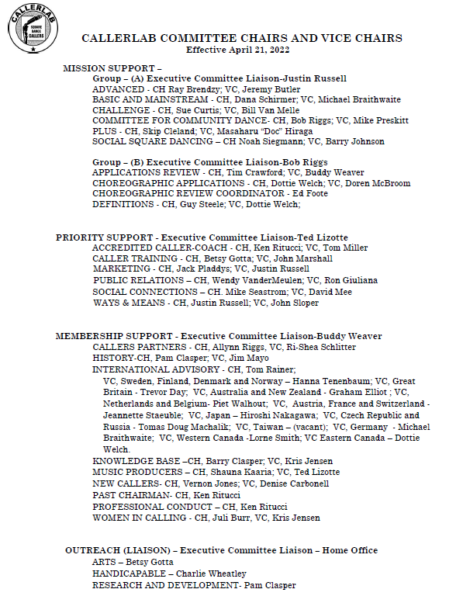
Committees
Almost all of the work accomplished by CALLERLAB is done by the various committees. The work of committees is one of the most important reasons for the existence of CALLERLAB.

Slide 7
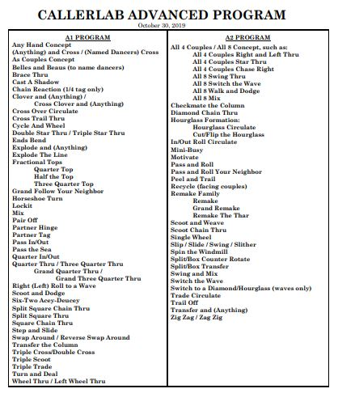
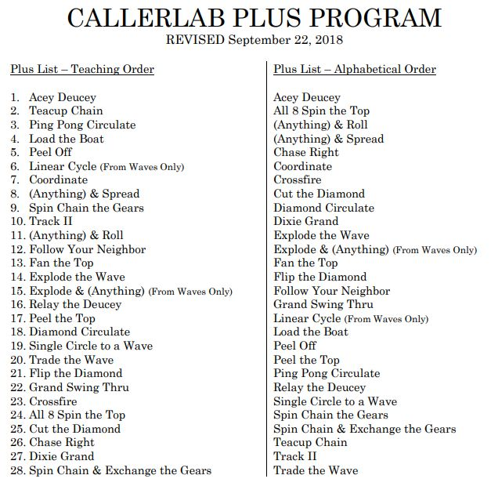
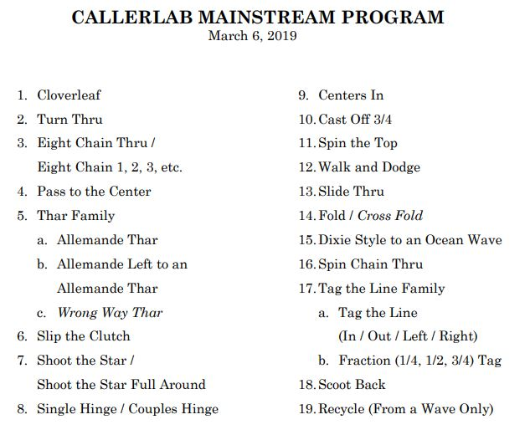
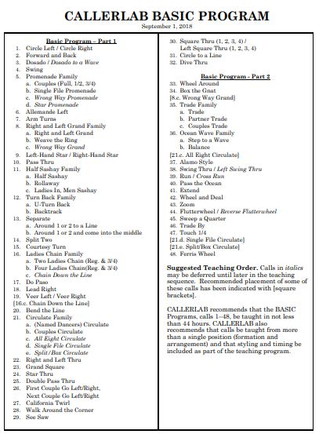
Program Lists
The standardization of program lists and call definitions allows a square dancer to travel anywhere in the world and dance the same calls he/she learned at home.

Slide 8
Trivia: Who decides what calls are on the program list?
The Board of Governors
Home Office Staff
Committee Chair
Program Committee Members

Slide 9
Trivia: Who decides what calls are on the program list?
The Board of Governors
Home Office Staff
Committee Chair
Program Committee Members

Slide 10
Insurance and Licensing in USA
Insurance is available for all callers in the USA. It provides Liability coverage.
CALLERLAB has negotiated with BMI and ASCAP to allow the licensing of callers rather than individual clubs. All callers who call in the US must be licensed.

Slide 11
Scholarships
Any caller can apply for a scholarship to attend a Caller School. Priority goes to applicants with less than five years of experience.

Slide 12
Documents
CALLERLAB creates and maintains a wide range of caller training documents, most of which are available to any caller or dancer by downloading from the website at no cost. The definition documents and some others have been translated into one or more foreign languages.
Dance Program lists and Definitions
Teaching Tips, Lost Squares Procedure
Formation and Arrangement charts
Winning Ways for club success
Community Dance Journals
Sight and Module Resolution Systems
Marketing Manual

Slide 13
KnowledgeBase
Knowledge.CALLERLAB.org
Contains 241 articles grouped into 26 categories and described with 44 different information tags.

Slide 14
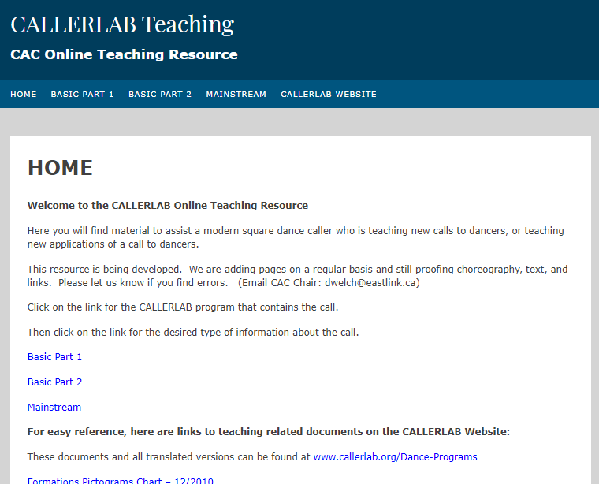
Teaching
Teaching.CALLERLAB.org
Definition
Standard Applications
Call Analysis
Modules
Teaching Tips
Choreography

Slide 15
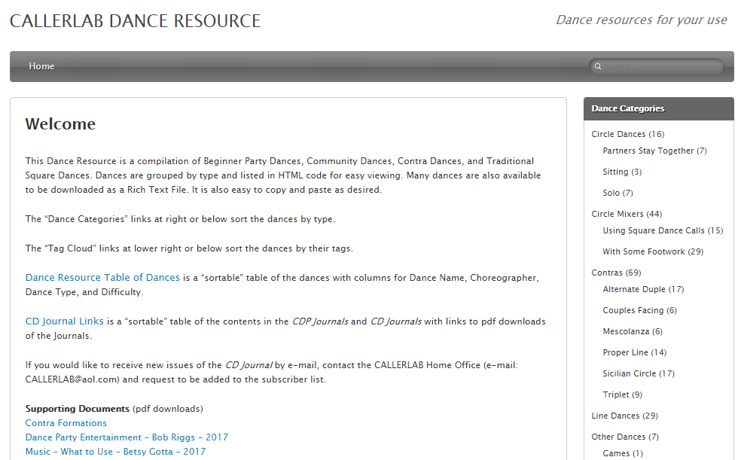
Dances
Dances.CALLERLAB.org
Beginner Party Dances, Community Dances, Contra Dances,
& Traditional Square Dances

Slide 16
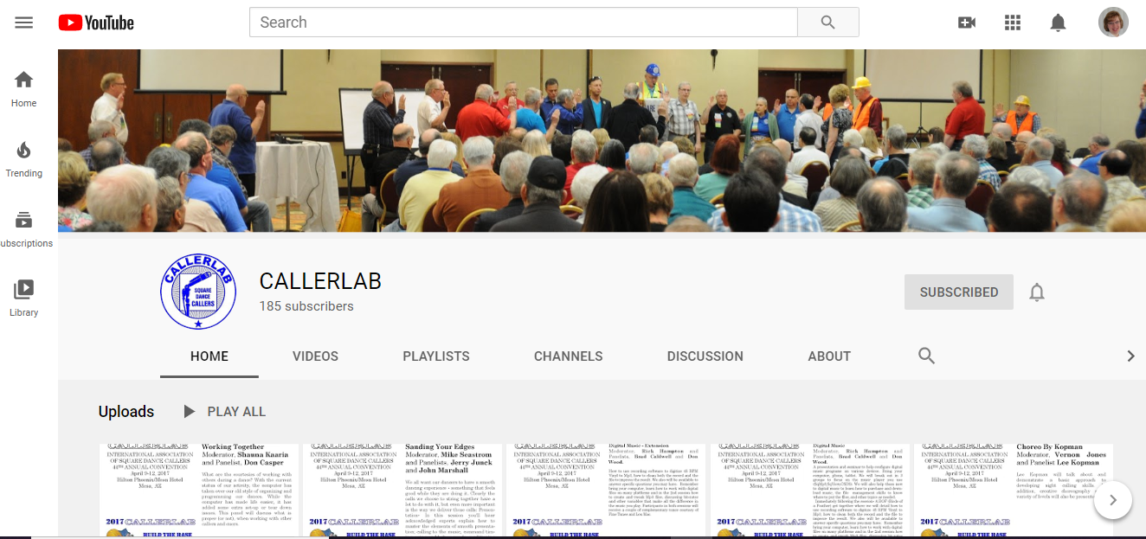
Resources
CALLERLAB YouTube Channel

Slide 17
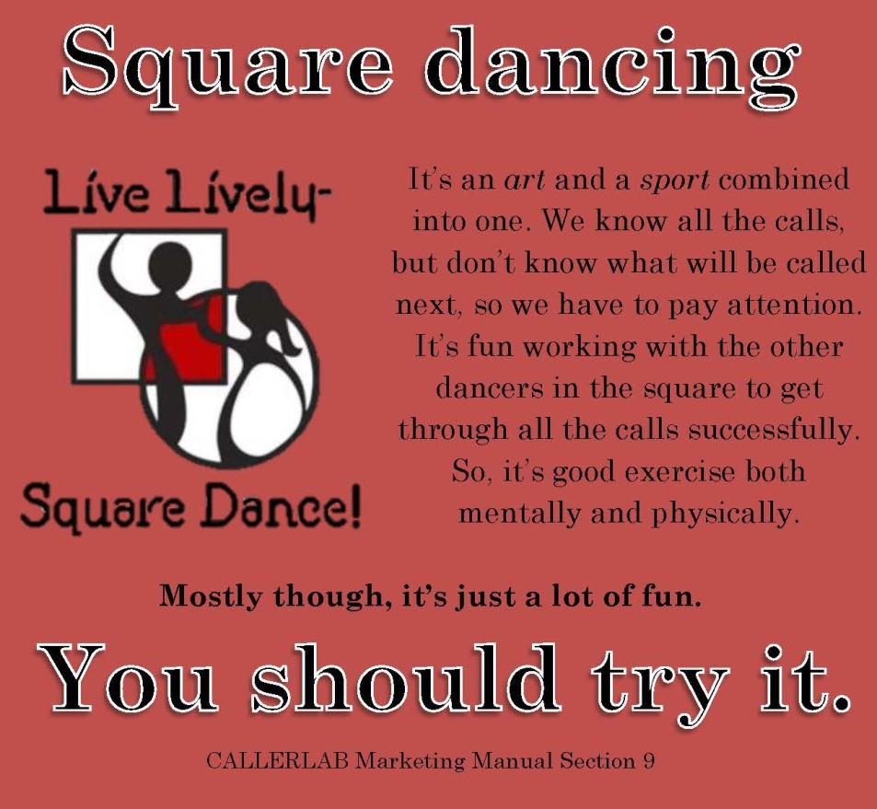
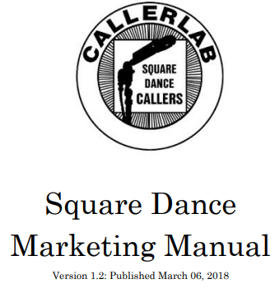
Resources
Marketing
Manual
Winning Ways Stories

Slide 18
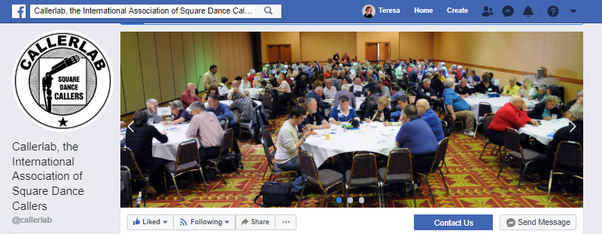
Resouces
CALLERLAB Facebook Page

Slide 19
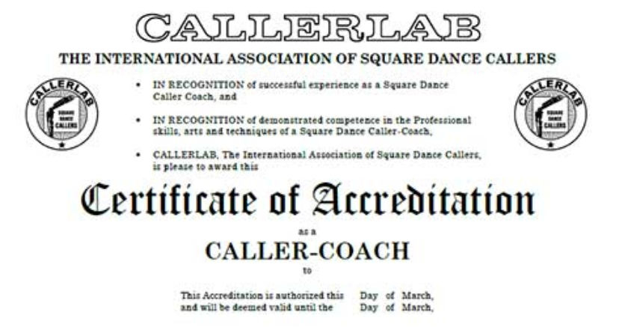
Accredited Caller Coaches
Callers who train callers may become an Accredited Caller Coach by completing CALLERLAB’s very in-depth study program and application process.
There are currently more than 30 CALLERLAB Accredited Caller Coaches who, cumulatively, have trained thousands of callers.

Slide 20
YOU are CALLERLAB!
Get involved
Attend Convention or Mini-Lab
Join a Committee
Run for the Board
Contribute an article for DIRECTION

Slide 21
Discussion
What do you see as CALLERLAB’s role for the industry?
What could CALLERLAB do to be more valuable for YOU?
What are some ways we can better serve our members?

Slide 22
CALLERLAB & The CALLERLAB Foundation
Square Dancing’s Professional Leadership Working For The Future!

Slide 23
Contact CALLERLAB
Our office staff are available 8:30 AM to 4:30 PM, Monday through Friday.
Phone: (785) 783-3665 Toll-Free: 1-800-331-2577 Fax: (785) 783-3696 Email: info@CALLERLAB.org

